Slide 1
Final Milestone Group 1 SEC 101
Gabriele Chiossi

Slide 2
Technology Stack and Tool Chain
We have been using VSCode to edit all our files. As well as a browser to look at the changes that we put in our code.
We used GitHub very often this milestone, because we had some problem so we had to go back a version of the website. Also used different branches when we were developing our unit testing.

Slide 3
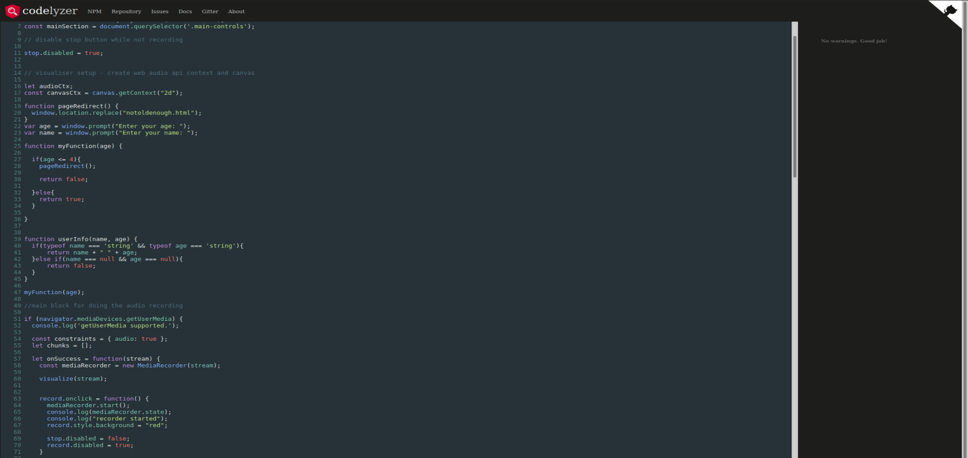
Static Analysis

Slide 4
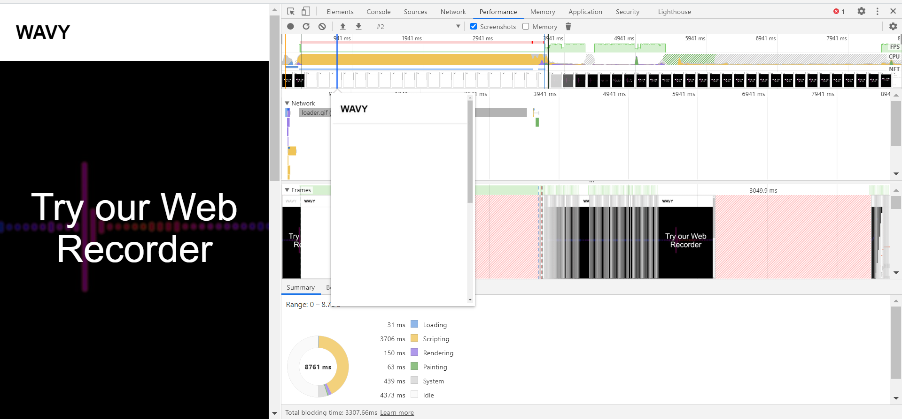
Profiling With Chrome Dev tool

Slide 5
Individual Responsibilities of All Members For This Milestone
Gabriele has fixed a problem with the deletion of the sound, earlier when we were clicking delete the stream would stay now when we delete the sound the stream goes away with it. Big part of this milestone was figuring out the test cases with mocha, it took him a while but he figured it out. Also he found an online static analysis tool that we use to do our static analysis part of the project. He launch the website on github.io

Slide 6
Individual Contributions During The Entire Project
Gabriele: it was rough at the beginning we had a lot of people dropping and we could not make up our ideas on what to do. So, I took the lead and decided to do the given project in a web format. Develop the front-end and back-end. I was the manteiner for github. Created all the powerpoints. Develop the unit testing. Keep professors updated on the team situation. Try to find times every week where everybody could meet, when we were more than just two.

Slide 7
Technology/Device Access of all Members
We have a lot of different technological devices that we have access to. We have been using all of the devices below to get the system to work on multiple platforms.
WINDOWS OS
LINUX OS (Virtual Machine, heavy use for this milestone on Gabriele’s side)
TEAMS (to comunicate via videocall)
iMessage (to chat daily and update the team)
Browsers: Chrome and Firefox mainly

Slide 8
Reflection on this project
Gabriele: very helpuful project, learned a new language and all the tool that goes around it. Now with this knowdlege i came up with an idea that i will probably develop here in the next year, using HTML5, CSS3, JavaScript ad SQL. Learned how to use github more deeply and a more extended knowledge on ssh. All around very good project. Only regret is not having enough time to actually do what I wanted to do with this project.

